Slide 1


Opioid overdose and naloxone administration
September 2018

Slide 2
Acknowledgments
The carrynaloxONe toolkit was created by the Ontario Harm Reduction Network (formerly the Ontario HIV and Substance Use Training Program) with support from the Provincial System Support Program at the Centre for Addiction and Mental Health.
Funding for carrynaloxONe was provided by the Ontario Ministry of Health and Long-Term Care.

Slide 3
What is an overdose? What is naloxone?
An overdose happens when a person takes an amount of a drug, or combination of drugs, that is more than their body can handle.
As a result, the central nervous system is not able to control basic life functions, like breathing or body temperature, and the person may lose consciousness.
Both people new to taking drugs and people experienced with taking drugs can overdose.
Naloxone is a medication that can temporarily reverse an opioid overdose. It is safe and easy to use.

Slide 4
What are opioids?
Opioids include, but are not limited to, medications prescribed by doctors to treat pain.
Opioids might also be taken or used to get high.
Examples of opioids:
  Codeine (Tylenol #1, #2, #3)
  Oxycodone (Percocet, OxyNEO)
  Hydromorphone (Dilaudid)
  Meperidine (Demerol)
  Methadone
  Fentanyl (and analogues)
  Heroin

Slide 5
Opioid overdose signs and symptoms
Person can’t be woken up
Breathing is slow or has stopped
Snoring or gurgling sounds
Fingernails and lips turn blue or purple
Pupils are tiny or eyes are rolled back
Body is limp
Source: Ontario Ministry of Health and Long-Term Care, 2018

Slide 6
Responding to an opioid overdose

Slide 7
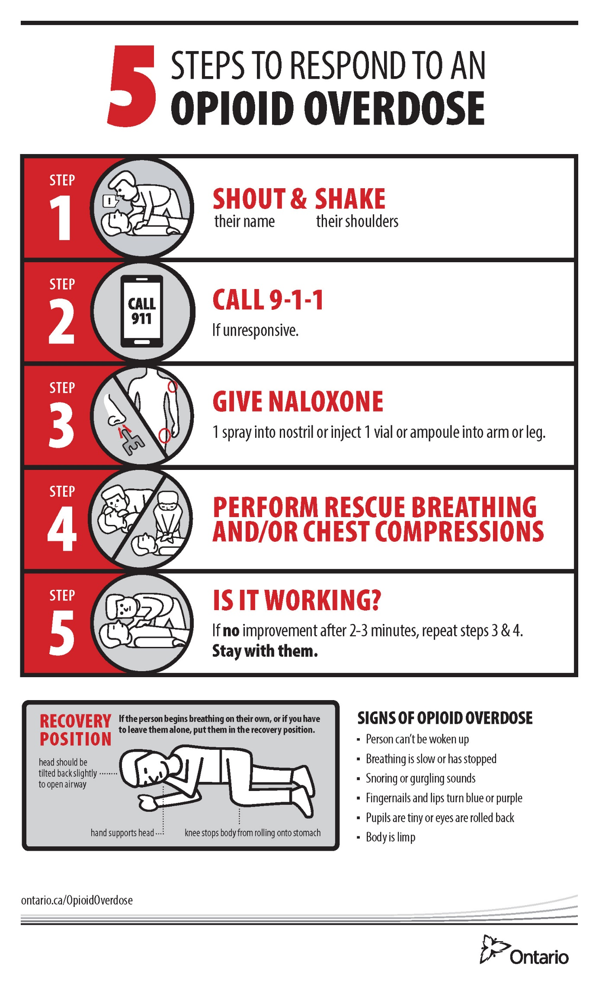

5 steps to respond to an opioid overdose
Source: Ontario Ministry of Health and Long-Term Care, 2018

Slide 8

Step 1 – Shout and Shake
Is the person responsive? Perhaps they are just sleeping.
Stimulate with NOISE.
Shout their name.
Say, “Hey, are you ok?”
Stimulate with TOUCH.
Tell the person what you are doing before you touch them.
  “Hi… I’m just checking that you’re OK.”
Shake their shoulders.
Rub your knuckles hard on their chest bone or under their nose.
Pinch their ear lobe.

Slide 9
Are they responding?
If the person responds to stimuli, keep an eye on them.
  Do not leave them alone in case the drugs they took have not fully taken effect – they could still overdose.
If the person does not respond to Step 1, proceed to Step 2, calling 911.

Slide 10
Step 2 – Call 911
If the person is unconscious, call 911.
Some dispatchers will ask if you need ambulance, fire or police.
Speak calmly and clearly.
Tell the dispatcher someone is unconscious and not responding.
… continued…

Slide 11
Step 2 – Call 911
Listen to the dispatcher’s questions rather than trying to tell them what has happened.
Explain exactly where you are and give address, intersection or landmark.
After you call 911, continue immediately to Step 3, administering naloxone, while you wait for help to arrive.
Tell the first responders as much as you know about what drugs the person took and what you have done, like administering naloxone.

Slide 12
Reluctance to call 911
Many people who use drugs have had bad experiences in hospitals and emergency departments and may be reluctant to seek medical care.
Drug use is criminalized.
  Many people who use drugs have already been arrested and have had bad experiences with the police.
  They can be fearful of arrest.
In 2017, the Good Samaritan Drug Overdose Act was introduced.

Slide 13
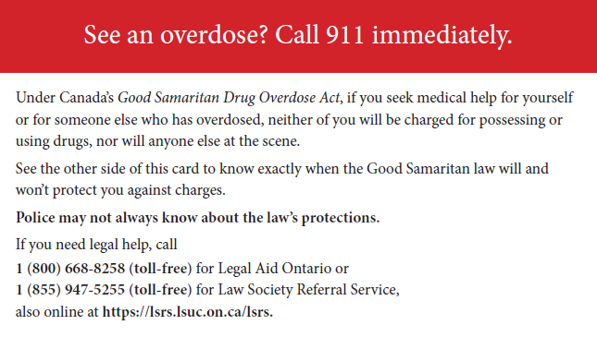
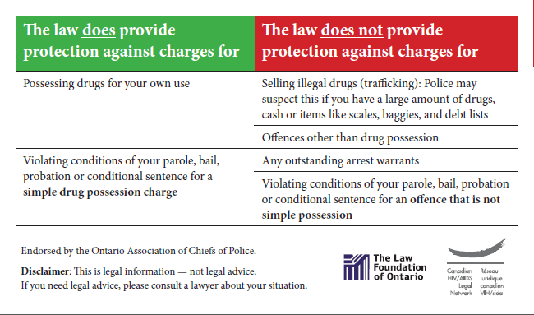
Good Samaritan Drug Overdose Act – wallet cards
English and French versions available for download from www.aidslaw.ca
Source: Canadian HIV/AIDS Legal Network, 2017

Slide 14
Step 3 – Give naloxone
Naloxone is a non-addictive, non-psychoactive drug that blocks the effects of opioids on the body
Temporarily reverses the effect of an opioid overdose
  There is no effect if naloxone is given to a person who has not used opioids
  If unsure, administer
Has been used by EMS routinely for over 40 years
Does not create a “high”
Works quickly (less than 5 minutes)
Wears off quickly (30-45 minutes)
Two forms available in Ontario – nasal spray and injectable

Slide 15
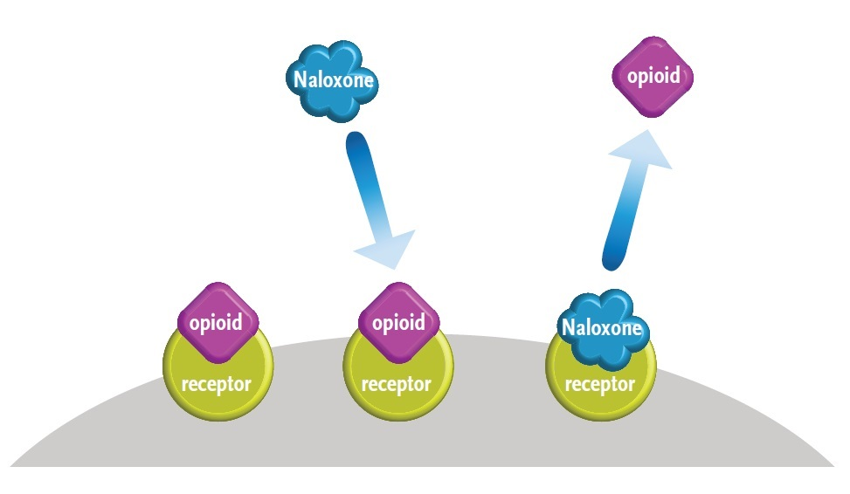
How naloxone works
The brain’s opioid receptors have a higher affinity for naloxone than for opioids. When naloxone is administered, it displaces opioids that are attached to the receptors, reversing opioid overdose.
Source: Centre for Addiction and Mental Health, 2016

Slide 16
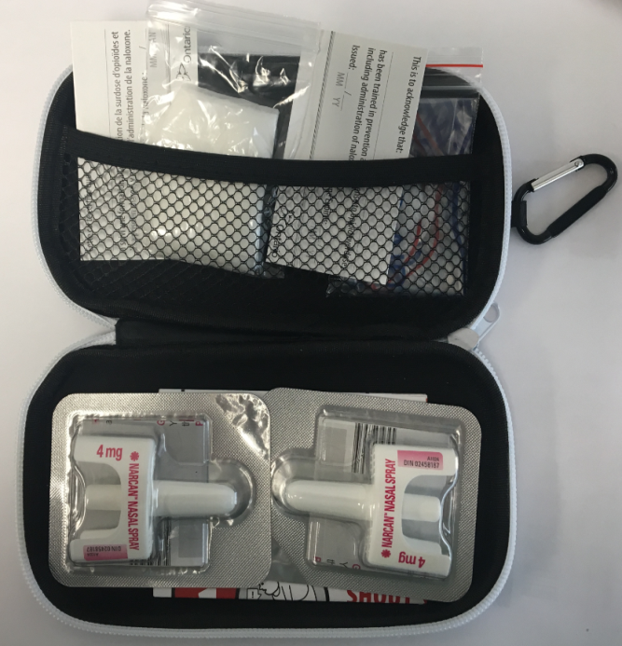
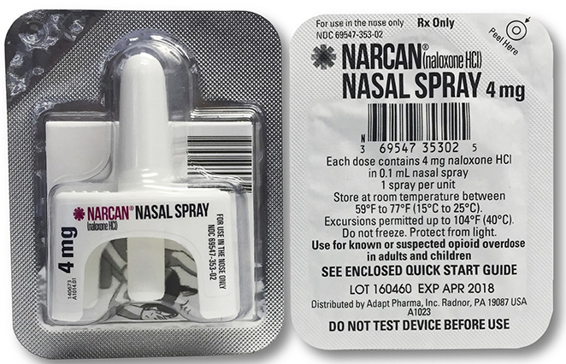
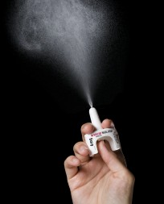
Nasal spray naloxone
Nasal spray naloxone is also known by the brand name “Narcan”
Administered into the nostril; does not require breathing to be absorbed across the mucosal lining
Source: Adapt Pharma Canada, 2017; Ontario Ministry of Health and Long-Term Care, 2018

Slide 17
Contents of nasal naloxone kit
2 doses of nasal spray naloxone (inside a sealed package)
1 pair of non-latex gloves
1 breathing barrier
1 bilingual instructional insert
2 identifier cards (1 English & 1 French) showing that the person has received training in naloxone use, and the expiry date of the naloxone

Slide 18
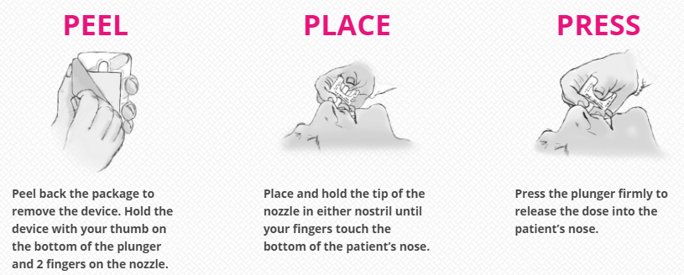
How to administer nasal naloxone
Lay the person on their back, wipe the nose clear if necessary and keep the head tilted backwards slightly with one hand.
Do not touch the plunger until the device in the person’s nostril, otherwise you may accidentally trigger the spray.
Source: ADAPT Pharma Canada, 2017

Slide 19
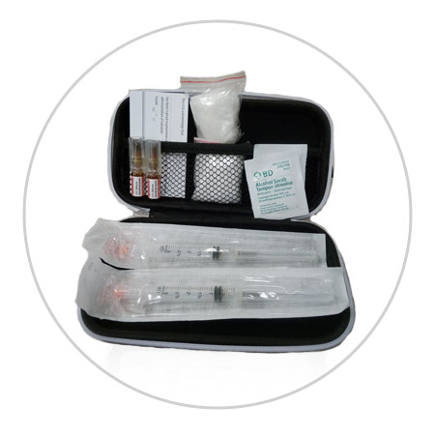
Injectable naloxone
Source: Ontario Ministry of Health & Long-Term Care, 2018

Slide 20
Contents of injectable naloxone kit
2 ampoules of naloxone
2 ampoule snappers – these help open the ampoules safely
2 syringes
2 alcohol swabs
1 pair of non-latex gloves
1 breathing barrier
1 bilingual instructional insert
2 identifier cards (1 English & 1 French)

Slide 21
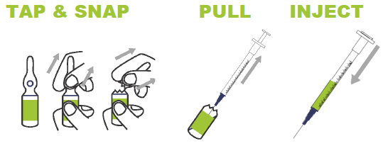
How to administer injectable naloxone
Grasp the top (narrow end) of the ampoule between the thumb and forefinger.
  Use the supplied snapper or alcohol pads to help grasp if you like.
Swirl or tap the ampoule so the liquid falls down into bottom.
Still holding the top of the ampoule, now take the thumb and forefinger of your other hand and grasp the bottom end.
Snap the ampoule away from you.
Remove a syringe from its packaging and take the protective plastic cap off the needle.
… continued…
Source: Adapt Pharma Canada, 2017

Slide 22
How to administer injectable naloxone
Insert the needle into the naloxone ampoule and pull up the plunger so the naloxone enters the syringe.
Turn the syringe so the needle is pointing in the air and tap it so any air bubbles flow to the top.
  Slowly push the plunger to expel the air bubbles.
  Don’t worry as a little bit of air will not hurt the person.
Insert the needle at a 90 degree angle into the large muscle of the thigh or upper arm.
  You can inject someone through their clothing if you need to.
Push down on the plunger until all of the naloxone is injected.
Dispose of the needle and ampoule in a plastic, puncture proof container like a sharps container or a water bottle.
Note the time or set a timer on your phone. You will want to know how long it has been before possibly giving another dose.

Slide 23
Heavy nod versus overdose
The most significant danger from opioid overdose is that breathing is too slow and the person does not get enough oxygen.
Sometimes a person may not be overly responsive to shouting and shaking, but their breathing is OK.
Check to see how well the person is breathing…

Slide 24
How to check for breathing
If the person does not respond to shaking and shouting, check their breathing.
  Is their chest and/or stomach rising and falling?
  Place the back of your hand over their mouth; can you feel their breath?
  Hold the glass screen of your mobile phone over their mouth; does it fog up?
If the person is breathing, put the person in the recovery position and keep monitoring them until they are more alert.
  The recovery position will keep their airway clear and open.
  It will also prevent them from choking if they vomit.

Slide 25

Recovery position
First, place the person’s arm nearest you at a right angle to their body, with the palm facing upwards.
Take their other arm and place it so the back of the hand is against the cheek closest to the ground.
Lift their far knee so that it is at a 90 degree angle, and roll them onto their side.
When you are finished, the top arm should be supporting the head to keep the airway open, and the bent leg should be on the floor to stop them from rolling over too far.

Slide 26
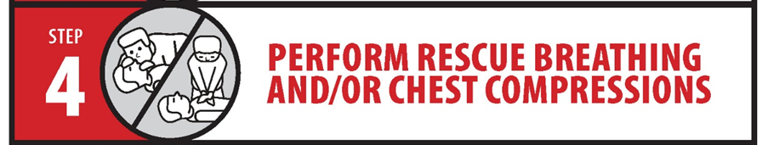
Step 4 – Perform rescue breathing and / or chest compressions
Depending on whether or not the person is breathing, and your training and comfort level, put the person in the recovery position or perform rescue breathing and/or chest compressions.

Slide 27
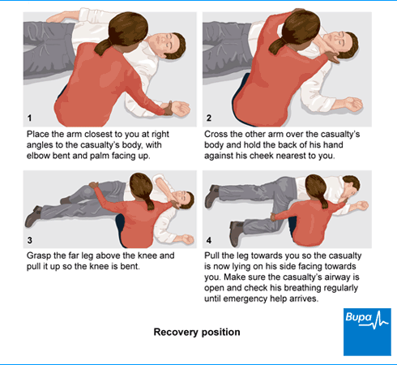
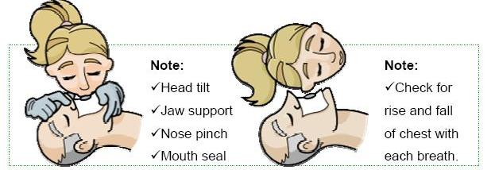
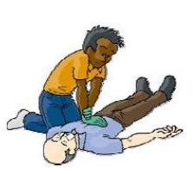
Step 4 – Perform rescue breathing and/or chest compressions
If breathing:
Recovery position
If not breathing:
Rescue breaths and/or chest compressions
Image source
Commence compressions with the person on a firm surface.
Hands are positioned over middle of chest.
Depress chest to one third depth.
Source: Bupa, 2018; SIE Learning, 2018

Slide 28

Step 5 – Is it working?
Continue performing rescue breathing and/or chest compressions after administering naloxone, if necessary.
Naloxone usually starts working in 2-3 minutes. After this time, check their breathing again.
If the person is not responding, administer a second dose.
  Use the other nostril if administering nasal spray.
  If you have access, use injectable naloxone if nasal isn’t working – the person’s nasal passage may be blocked.
  If using injectable, inject a second ampoule.
You can keep repeating doses as necessary, if you have access to additional doses.
Continue rescue breathing and/or chest compressions until the person becomes alert or until help arrives.
Source: Ontario Ministry of Health and Long-Term Care, 2018

Slide 29
If naloxone is NOT working
Reasons a person may not respond to naloxone:
The person is not under the influence of opioids.
  Administering naloxone will not harm them.
  There could be another serious medical issue.
A higher dose of naloxone is needed.
  Some fentanyl analogues require additional doses of naloxone.
911 should already have been called regardless.

Slide 30
After an overdose
When naloxone starts working the individual may:
Wake up suddenly or slowly.
Experience mild to severe withdrawal symptoms.
  They may feel sick or be sweating; they may also throw up or soil themselves.
  Explain that these symptoms will go away as the naloxone wears off (30-90 minutes).
Want to use more drugs
  Explain that taking more drugs will be a waste as the naloxone will block any more drugs’ effects.
  It can also further increase the risk of overdosing again.

Slide 31
Caring for someone after an overdose
Provide emotional support and reassurance, and explain what has happened.
Monitor and prepare in case they lose consciousness again as the naloxone wears off.
  Let them know more naloxone may need to be given if that happens.
If paramedics were not called, suggest a trip to the hospital for further observation.
Check in with a friend or colleague if you need to debrief afterwards. Self-care is important.

Slide 32
Overdose response myths
Do Not | Risks
Put the person in a bath/cold water | Person could drown or go into shock
Induce vomiting | Could cause choking
Inject them with anything (saltwater, cocaine, milk) other than naloxone | Will not help and could cause more harm
Slap them too hard, kick them in the testicles, burn the bottom of their feet | Could cause serious harm
Let them sleep it off! | Person could stop breathing and die
Notes:
OK, so what should I do if I think someone has overdoses on opioids?
Well, first, let me tell you what not to do:
Cold water
Vomit
Let me show you how to respond then…
OR WEAVE THESE IN WITH THE STEPS?

Slide 33
Preventing opioid overdose

Slide 34
Preventing opioid overdose
Reducing the risk of an opioid overdose if using prescription opioids:
Consider locking up your opioids.
Keep them away from children, youth and other adults in your home.
Return unused opioids to a pharmacy. Do not keep them for the future – if you need them, a doctor will prescribe them to you.
Don’t give anyone else your prescription opioids for any reason, or take opioids prescribed to someone else.

Slide 35
Preventing opioid overdose
Key principles for preventing opioid overdose:
Do not use alone
Be aware of your tolerance
Avoid mixing drugs
Know the quality of your drug(s)

Slide 36
Don’t use alone
If you overdose alone, no one will be able to help you.
Prevention:
  Fix with a friend
  Call someone to let them know you are about to use
  Set up call or text check-ins
  Leave your door unlocked

Slide 37
Be aware of your tolerance
A person’s ability to withstand the effects of a drug
  Develops over time
  Can be affected by: age; weight; health; stress; situation
  Can rapidly decrease when they have taken a break from using either street or prescription drugs
    E.g., time in prison; drug treatment programs; hospital stays
Prevention:
  Use less drugs when tolerance may be lower
  Use small amounts to test your tolerance
  Use by smoking, snorting or swallowing instead of injecting

Slide 38
Avoid mixing drugs and substances
Many overdose deaths occur when multiple and different types of drugs have been taken.
Prevention:
  Avoid mixing drugs
    Especially depressants like benzodiazepines, other opioids and alcohol
  Try to use only one drug at a time
  If you are mixing, use less of each drug

Slide 39
Know the quality of your drug(s)
Drug quality is unpredictable. Illegal drugs are unregulated; therefore, their purity and strength can be different with each batch, even from the same dealer.
Prevention:
  Know your dealer; try to stick to the same source
    Ask if they have a new supply
    Ask others if they have tried a particular batch
  Does the drug look, smell or taste different?
  Access drug checking kits or services if you are able
  Try a small dose to start (start slow)

Slide 40
Remember….
Carry your naloxone kit with you at all times.
Store naloxone at room temperature and away from light.
  Leave the spray or ampoules in the container your kit comes in.
  Don’t leave it in a car on really hot or really cold days.
Check the expiry date on your naloxone regularly!
Encourage other people you know to carry naloxone.
Seek support if you have been involved in an overdose.
Report using your naloxone kit and get it replaced.
Find free naloxone kit locations:
  www.ontario.ca/page/get-naloxone-kits-free

Slide 41
References
ADAPT Pharma Canada (2017). This is Narcan nasal spray. www.narcannasalspray.ca/en
Bupa (2018). Recovery position. https://www.bupa.com/
Canadian HIV/AIDS Legal Network (2017). Good Samaritan Act wallet card. http://www.aidslaw.ca/site/see-an-overdose-call-911-immediately/?lang=en
Canadian Red Cross (2017). Compression-only CPR. http://www.redcross.ca/training-and-certification/first-aid-tips-and-resources/first-aid-tips/compression-only-cpr
Carter, C. (2012). What is naloxone? Canadian Drug Policy Coalition. http://drugpolicy.ca/blog/2012/08/what-is-naloxone/
Carter, C. & Graham, B. (2013). Opioid overdose prevention and response in Canada. Canadian Drug Policy Coalition. https://drugpolicy.ca/wp-content/uploads/2013/01/CDPC_OverdosePreventionPolicy_Final_July2014.pdf
Centre for Addiction and Mental Health (2016). Opioids and addiction: A primer for journalists. https://www.porticonetwork.ca/documents/77404/475940/Media+Primer+for+Journalists-Guide/a09be187-0fbc-4dd3-9c2a-ffb8657472ec
Ontario Harm Reduction Program (2017). Opioid overdose prevention. http://www.ohrdp.ca/opioid-overdose-prevention/
Ontario Ministry of Health and Long-Term Care (2018). Recognize and temporarily reverse and opioid overdose. https://www.ontario.ca/page/get-naloxone-kits-free
https://www.ontario.ca/opioids
Public Health Ontario, Leece P. (2016). Evidence brief: Evidence on rescue breathing or chest compressions in local naloxone programs. https://www.publichealthontario.ca/en/eRepository/Evidence_Brief_CPR_Naloxone_Programs_2017.pdf
SIE Learning (2018). HLTFA 301B – Apply First Aid. https://sielearning.tafensw.edu.au/MCS/FirstAid_Ultimo/firstaid/

